Slide 1
The Gifting Company
Submitted To: Submitted By:
Mr. Dilip Balasubramanian Kartik Goel
Shubhi Yadav

Slide 2
About the Company
We make gifting effortless and memorable for your loved ones.
Offering premium candies and elegant jewelry for every occasion.
Whether birthdays, anniversaries, or special moments, we have the ideal gift.
Crafted with care to bring joy and lasting memories.
Personalized gifts to make every moment extra special.
Easy ordering, beautiful packaging, and timely delivery.

Slide 3
Aim of the analysis
Analyzing past Valentine's Day trends to craft the best offers.
Personalized discounts and deals for our ideal customers.
Smart marketing campaigns based on consumer behavior.
Special offers tailored to make gifting more delightful.

Slide 4
Dashboard

Slide 5
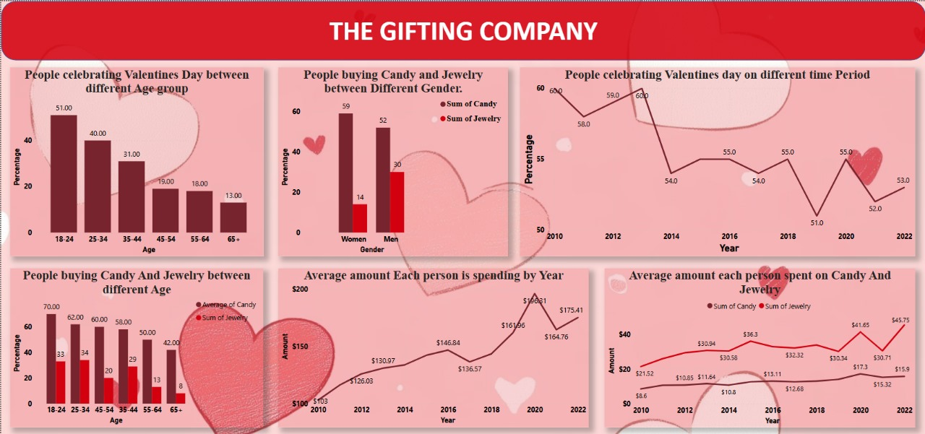

Slide 6
Conclusion
The 18-24 age group is a prime target for promotional campaigns.
Younger consumers prefer candies, while middle-aged customers lean toward jewelry.
Male consumers are increasingly spending on jewelry, presenting an opportunity for targeted offers.
Marketing Strategy Recommendations:
Personalize discounts and deals based on consumer preferences.
Focus on candies for younger audiences and jewelry for middle-aged buyers to maximize engagement.
Introduce exclusive jewelry offers for male buyers to boost sales further

Slide 7


